Slide 1
Monterey Bay Minecraft Mod
12.5.14
Team: Loops on Loops
Sponsor: MakersFactory

Slide 2

Our Team
Joe Wise
John Kang
Brian Lee
Paul-Valentin Mini
Max Hufft
Desmond Vehar
Sponsor: Joe Allington

Slide 3

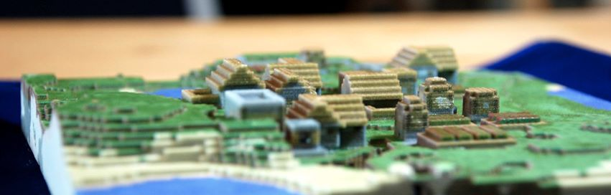
MakersFactory
3D learning solutions company that offers classes, products, and services to educate students, teachers, and communities

Slide 4
Project Overview
What is our project?
Educational Minecraft Mod
Reason for project
Teach kids about the Monterey Bay

Slide 5
Goals
Fill Minecraft’s oceans with local marine life
A Submarine and Scuba gear to help explore the ocean
Alter water overlay
In game objectives to support teachers’ lesson plans
Notes:
1st Bullet: Animals and plants
3rd Bullet: Currently a player in the water can not see very far

Slide 6
Accomplishments
Created many of the creatures we set out to do
Laid the groundwork for future iterations of the project
Notes:
The custom behavior/AI for the entities will be very useful when more entities need to be implemented

Slide 7
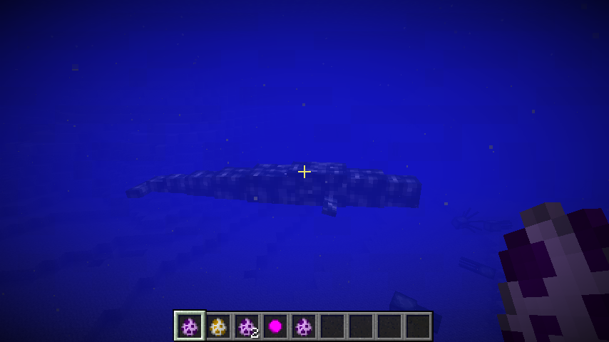
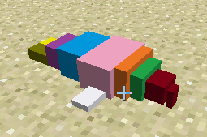
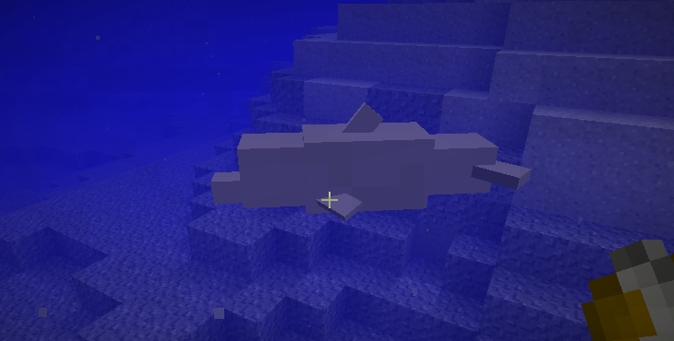
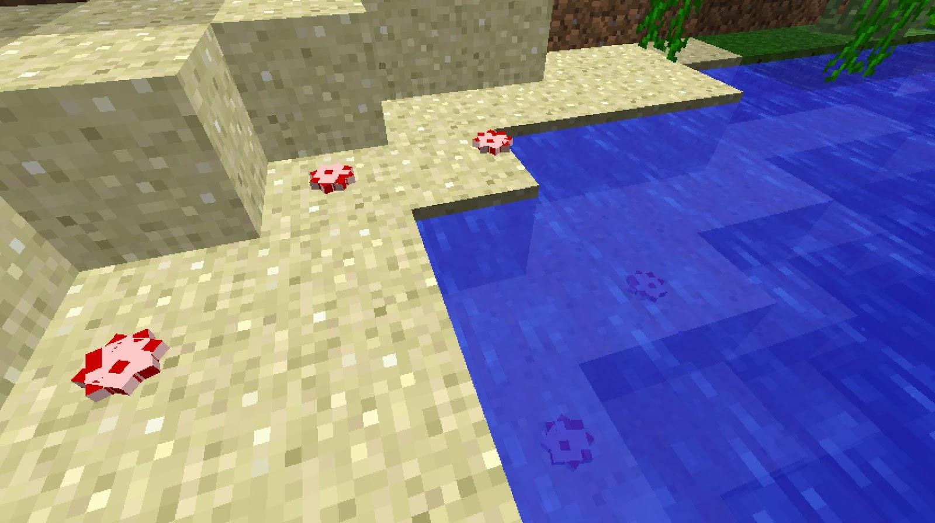
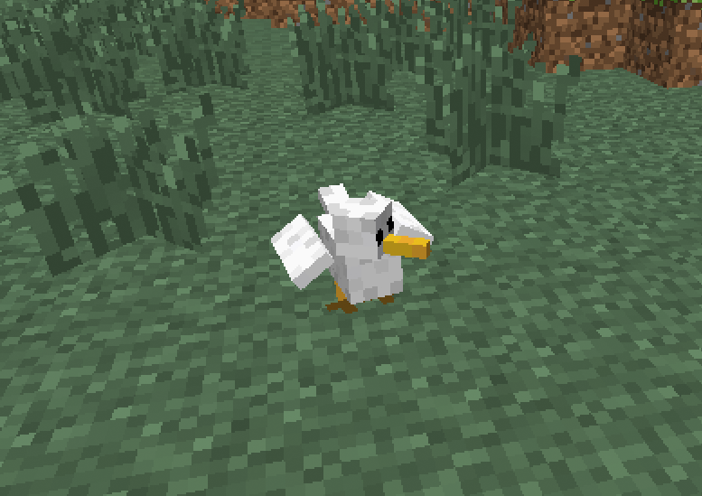
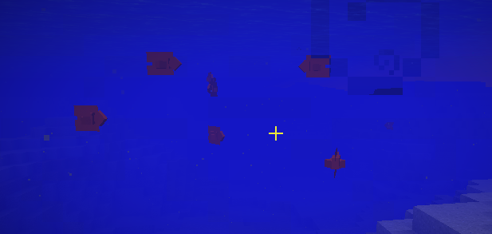
Gray Whale
Northern Elephant Seal
Bottle-nosed Dolphin
Starfish
Seagull
Garbaldi Fish

Slide 8
Problems Encountered
Entity Modeling is horrible
Techne
Forge Documentation is scarce
Not many tutorials
Poor quality
AI implementation
Notes:
“Forge Documentation is scarce”
We overcame this by studying the code and by consulting with our sponsor who has experience with Minecraft Mod implementation.

Slide 9
Experience with SCRUM
Does not allow for much preliminary work
Keeps meetings quick and to the point
Allows for the incremental development of features
Division of labor was easy for this project
Hard to get adjusted to
Hard to implement when there are competing priorities: other coursework
Notes:
First bullet: Difficult to accomplish user stories when the Forge framework needed to be learned first
Last bullet: Some meetings there were no updates

Slide 10
Future Plans
Create ocean health system
Design submersible
“Pokedex” to scan marine life for info
New marine biomes
Support lesson plans via in game objectives
Create new ways for students to learn about environmental responsibility
Notes:
L

